Slide 1
Time Series Outlier Detection
Hitesha Mukherjee - MS2016007
Srinivasa Raghavan – MS2017008
Anoop Toffy – MT2016016

Slide 2
Problem Statement
Identification of outliers in Time Series data using robust statistical methods.

Slide 3
Dataset
The dataset is provided as part of the Yahoo! Web Scope program. The dataset consists of real and synthetic time-series with tagged anomaly points. The synthetic dataset consists of time-series with varying trend, noise and seasonality. The real dataset consists of time-series representing the metrics of various Yahoo services.
The A1Benchmark is based on the real production traffic to some of the Yahoo Servers. The other 3 benchmarks are based on synthetic time-series. A2 and A3 Benchmarks include outliers, while the A4Benchmark includes change-point anomalies. The synthetic data set contains time-series with random seasonality, trend and noise. The outliers in the synthetic dataset are inserted at random positions.

Slide 4
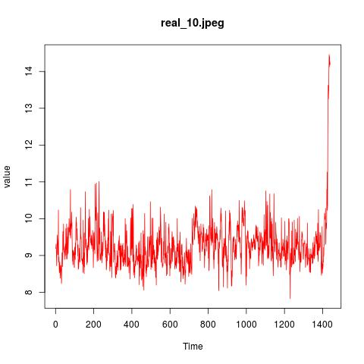
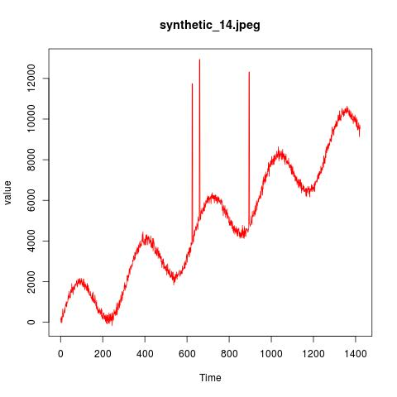

Slide 5
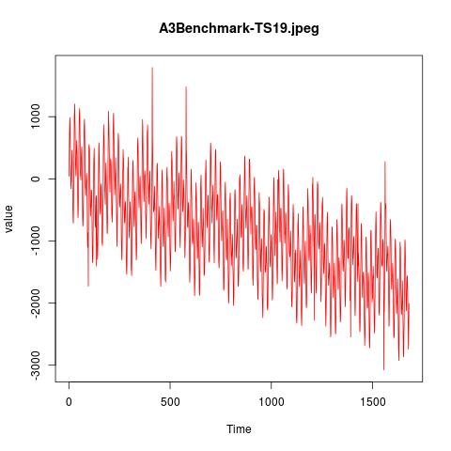
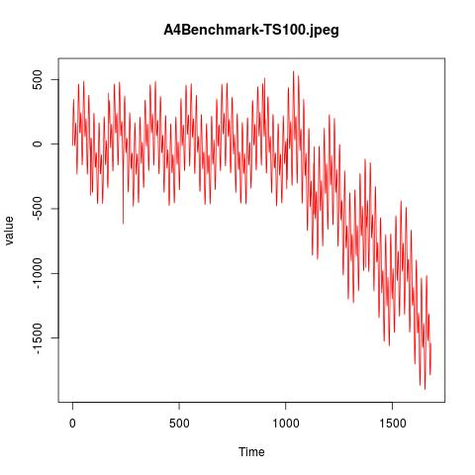

Slide 6
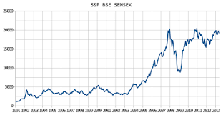

Time Series Analysis
A Time-Series is a sequence of data points corresponding to a set of observations made at a particular time instance e.g.- Rainfall data in a year, solar radiation data, speech signal, network traffic data, ECG and EEG data etc.
To model or analyze these signals, there is a need to understand the underlying pattern. These patterns may include components such as trends, seasonality, stochasticity, long term cyclicity and autocorrelation etc.

Slide 7
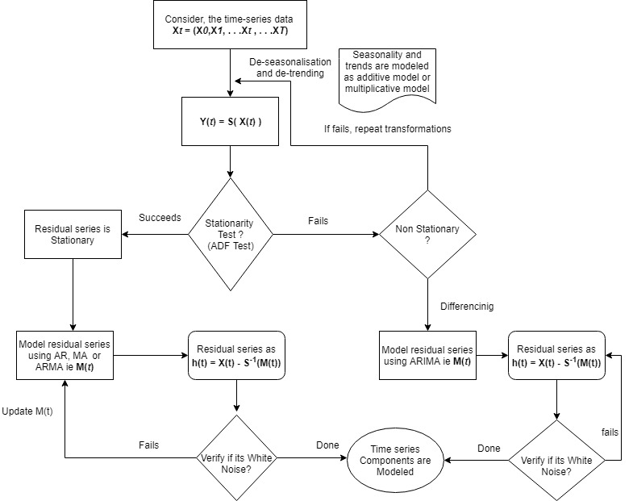

Slide 8
STL Decomposition
The process of extracting Seasonal Component, Trend Component and residue is referred to as Decomposition.
The task decomposing the series and removing the seasonality can be accomplished by simply subtracting the seasonal component from the original series. seasadj() is a convenient method inside the forecast package. We now have a de-seasonalized series.
Fitting an ARIMA model requires the series to be Stationary. A series is said to be stationary when its mean, variance, and autocovariance are time invariant.
The Augmented Dickey-Fuller (ADF) test is a formal statistical test for stationarity. The null hypothesis assumes that the series is non-stationary. ADF procedure tests whether the change in Y can be explained by lagged value and a linear trend. If contribution of the lagged value to the change in Y is non-significant and there is a presence of a trend component, the series is non-stationary and null hypothesis will not be rejected.
Our dataset is a stationary dataset, since p value obtained is less than 0.05. No differencing technique is needed.

Slide 9
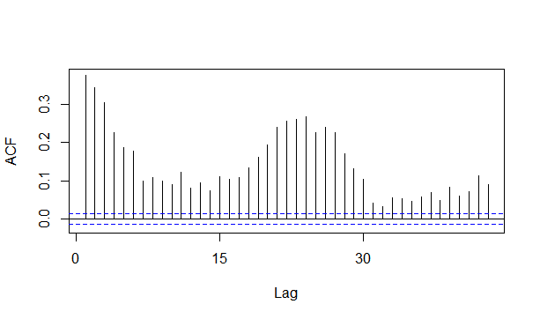
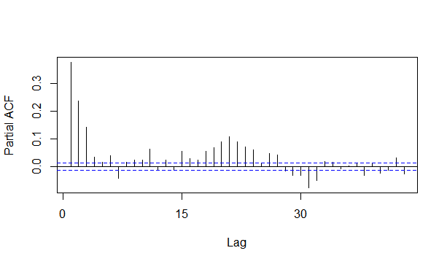
ARIMA MODEL
We determine the ACF and PACF for our dataset. We plot them for our dataset.
After determining the ACF and PACF and differencing factor.Now let's fit a model. The forecast package allows the user to explicitly specify the order of the model using the arima() function, or automatically generate a set of optimal (p, d, q) using auto.arima().
Two of the most widely used criteria are Akaike information criteria (AIC) and Baysian information criteria (BIC). These criteria are closely related and can be interpreted as an estimate of how much information would be lost if a given model is chosen. When comparing models, one wants to minimize AIC and BIC. This is for Arima

Slide 10

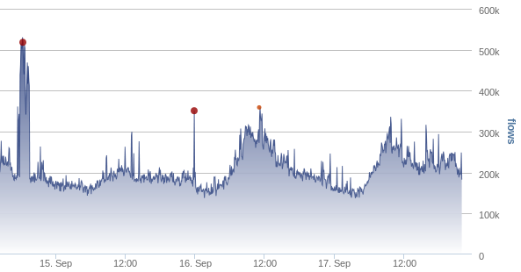
Outliers
Time series may sometime exhibit eccentric pattern that deviate from normal operating behavior because of the presence of outliers.
The data points which are lying outside the regular operating region which results in such deviating characteristics are referred to as outliers.

Slide 11
Types of outliers
Additive outliers (AO)
Level Shift outliers (LS)
Temporal change outliers (TC)
Innovation outliers (IO)

Slide 12
Approach
Joint estimation model parameters and outlier effects in time series for A1,A2,A3 Benchmark datasets
MARS modelling and recursive partitioning for A4 Benchmark dataset containing change points

Slide 13

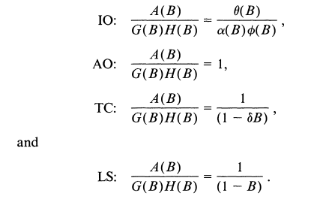
A. Joint estimation model parameters and outlier effects
Joint model equation

Slide 14
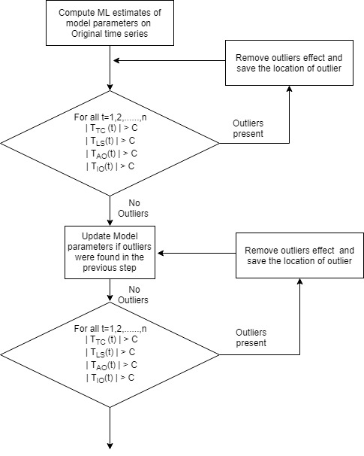
Iterative Procedure Stage 1 :Initial Parameter Estimation and Outlier Detection

Slide 15


Stage 2 : Joint Estimation of Outlier Effects and Model Parameters
After stage 1 we get m possible outlier locations t1,t2,…,tm
Joint equation

Slide 16
Stage 2 : continued
Out of the m outliers identified as the possible outliers. We re calculate the t-statistic and see if its effect is significant , if not remove it from the m outliers and repeat the process
Obtain the adjusted series from by removing the outliers effects
Compute the maximum likelihood estimates of the model parameters based on the adjusted series obtained. If the relative change of the residual standard error from the previous estimate is greater than epsilon repeat the above stage 1

Slide 17
Stage 3 : Detection of Outliers Based on the Final Parameter Estimates
Compute the residuals by filtering the original series based on the parameter estimates obtained in stage 2.
Obtain the adjusted series from by removing the outliers effects.
Use residuals and iterate through stage-1 and stage-2 to obtain the final model parameter estimates and outlier effects

Slide 18
B. MARS modelling and recursive partitioning for A4 Benchmark dataset containing change points

Slide 19
Approach B
If we have change points in the time series, we use Multivariate adaptive regression splines(MARS) fitting to find the knots/change points in the time series. Prior to applying MARS using EARTH (Enhanced Adaptive Regression Through Hinges) package in R we perform moving average smoothing.
After getting sub series using the knots, we use Approach A to find outliers.

Slide 20
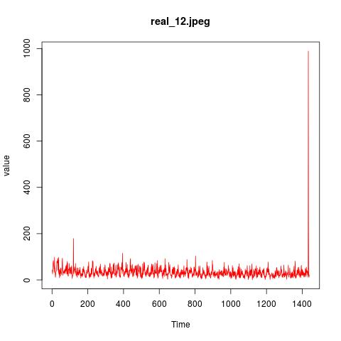
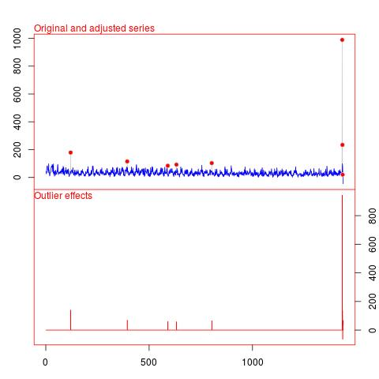
Results

Slide 21
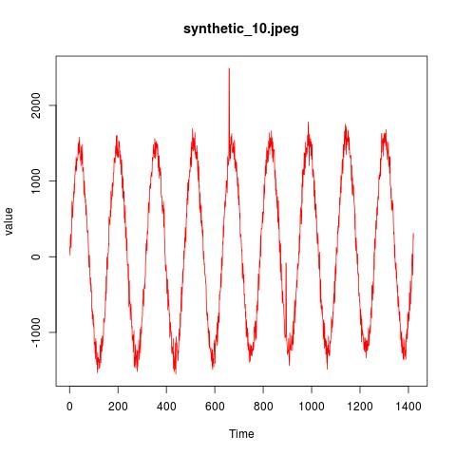
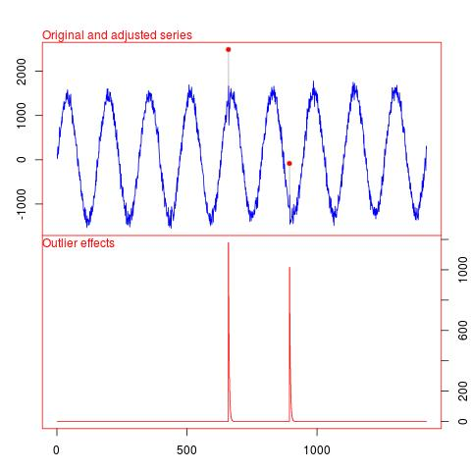
Results

Slide 22
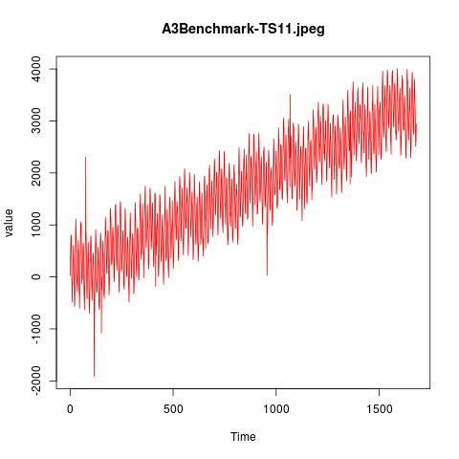
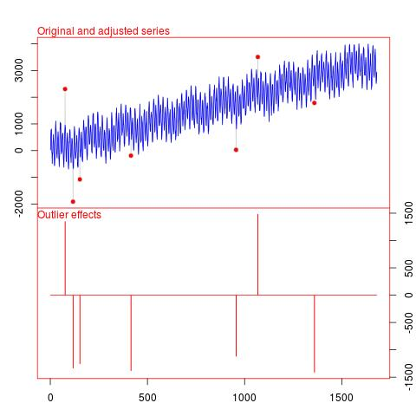
Results

Slide 23
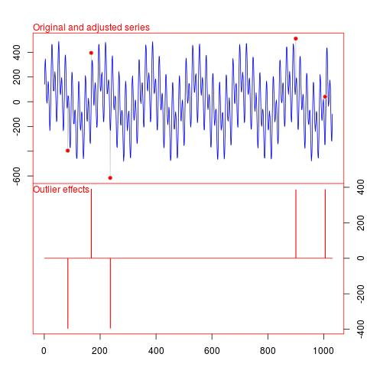
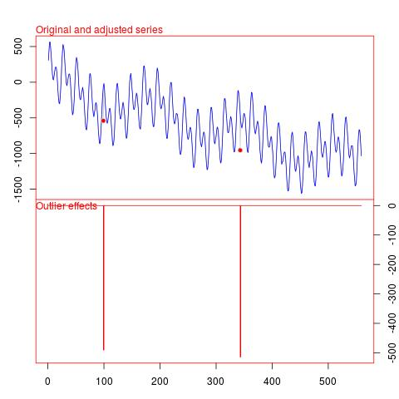

Slide 24
Questions

Slide 25
THANK YOU

